Slide 1
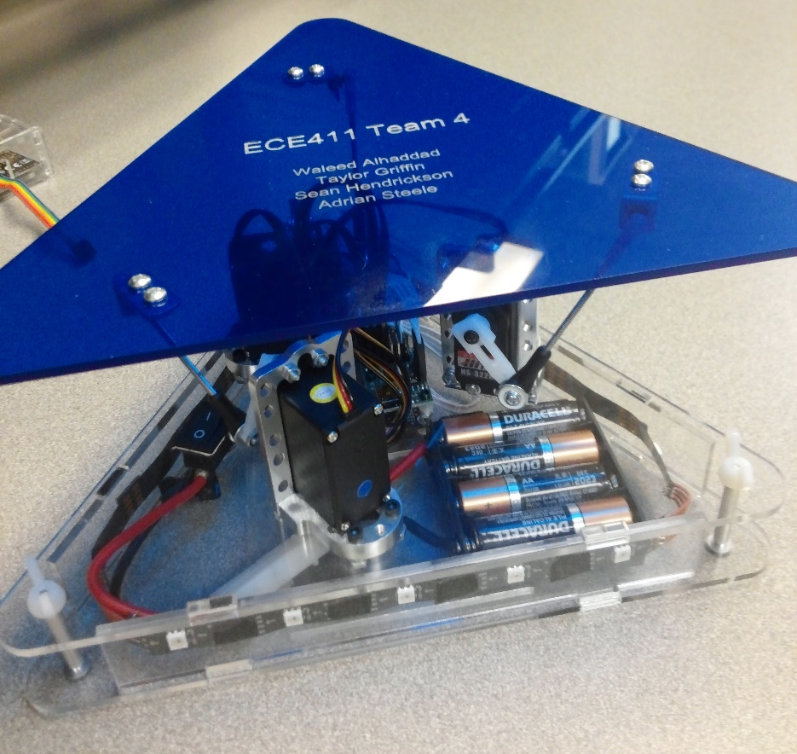
Team 04 – Self Leveling Table
Sean
Waleed
Adrian
Taylor

Slide 2

Problem or Need
Suitable project for practicum.
Waiters sometimes drop their tray’s contents.
Hard to keep things balanced.

Slide 3
Motivation
Get a good grade!
Resume material.
Good practice for capstone and career.
Cool gadget to play with.
Useful to keep things balanced.

Slide 4
Objective
Keep a tray level in real time.
Create working prototype in 10 weeks.
Entertaining to play with.

Slide 5
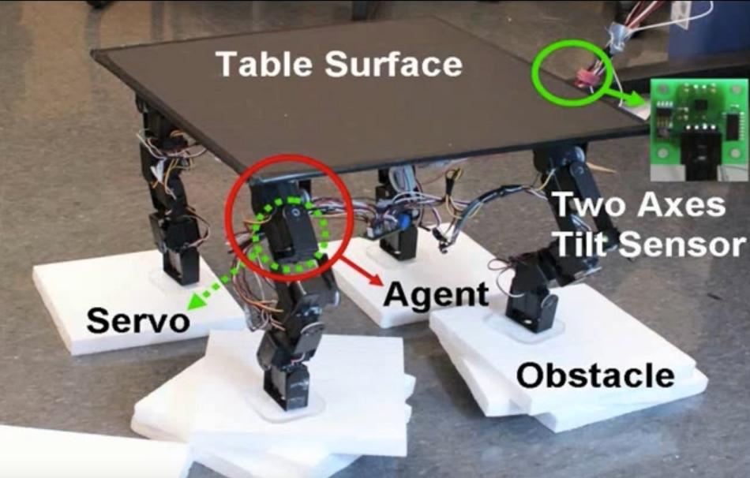
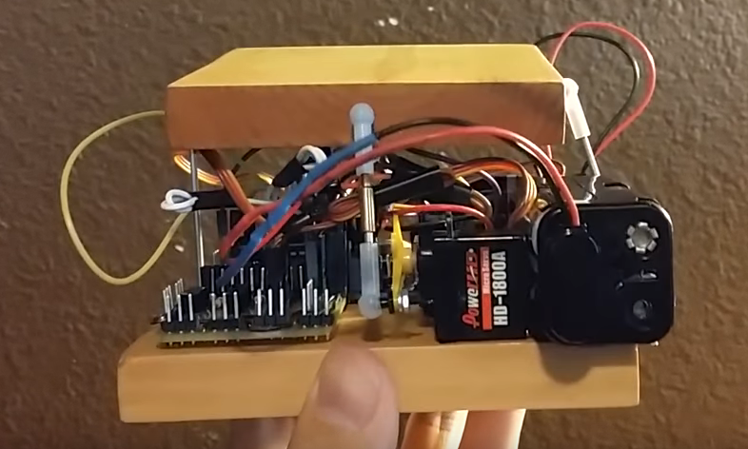
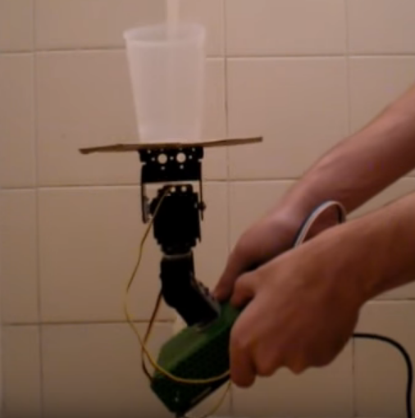
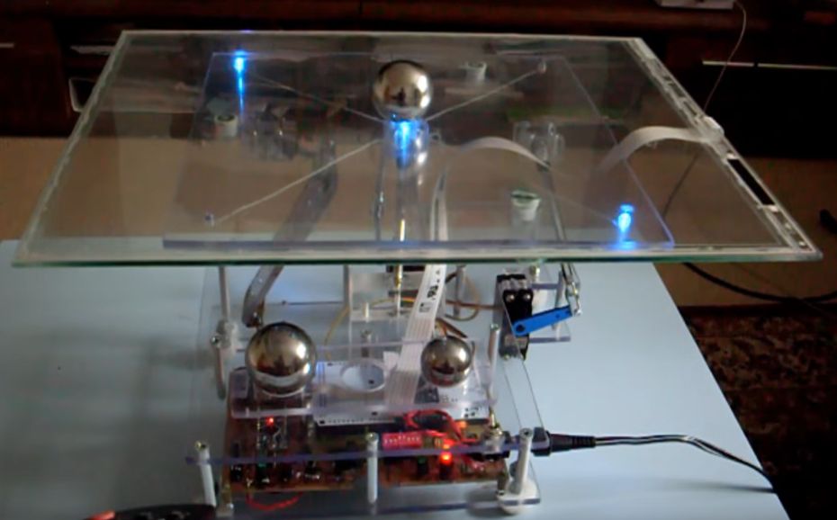
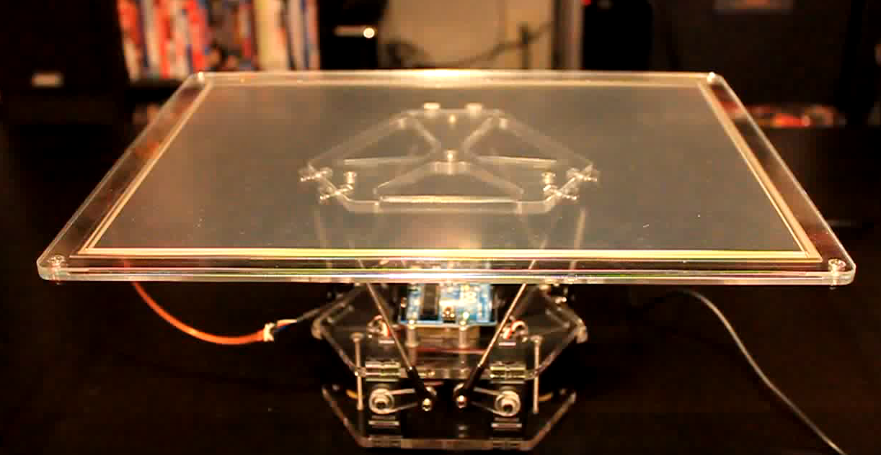
Alternatives

Slide 6
Marketing Requirements
The device should be easily held with two hands.
The device should hold an object on the table to balance.
The device should be responsive.
Should be simple and intuitive to use.
Should be visually appealing.
Should be inexpensive.
Should be safe.

Slide 7
Constraints
Must have at least one input (sensor) and at least one output (actuator).
Must have at least 2 layers on PCB.
Must have a microprocessor located on PCB.
Must have more than 25% surface mount components (1206).
Must have top-side silk screen.
Must not start from existing design file.
Must have live documentation and use revision control.
Must be published with MIT license.

Slide 8
Engineering Requirements
Functionality
The device should maintain a level position while powered on.
Performance
The device should level itself within 5 degrees.
Should move to a level position within 2 seconds of becoming unleveled.
Table should remain level up to 15 degrees relative to the horizontal.
Economic
Total parts cost will not exceed $200.

Slide 9
Engineering Requirements
Energy
The system will should run off batteries for at least 1 hour.
Health & Safety
Power system and components should be inaccessible to user.
Environmental
Should be manufactured with lead free solder.
Manufacturability
PCB should be greater than 1.5 sq. inch and smaller than 140 sq. inches.

Slide 10
Engineering Requirements
Operational
Device should be smaller than a cubic foot.
Device should not weigh more than 5 lbs.
Reliability & Availability
Table should hold .25 lb. without breaking.
Social & Cultural
Should have visual feedback system to relay angle state to user.
Usability
User should not need instructions to use device.

Slide 11
Our Approach
Triangular base with triangular top tray.
Three servos attached on the corners of the tray.
Receive input from an accelerometer and process in a microprocessor.
Send updated positions to servos based on device tilt.
Battery powered for portability.
Lots of LEDs for entertainment.

Slide 12
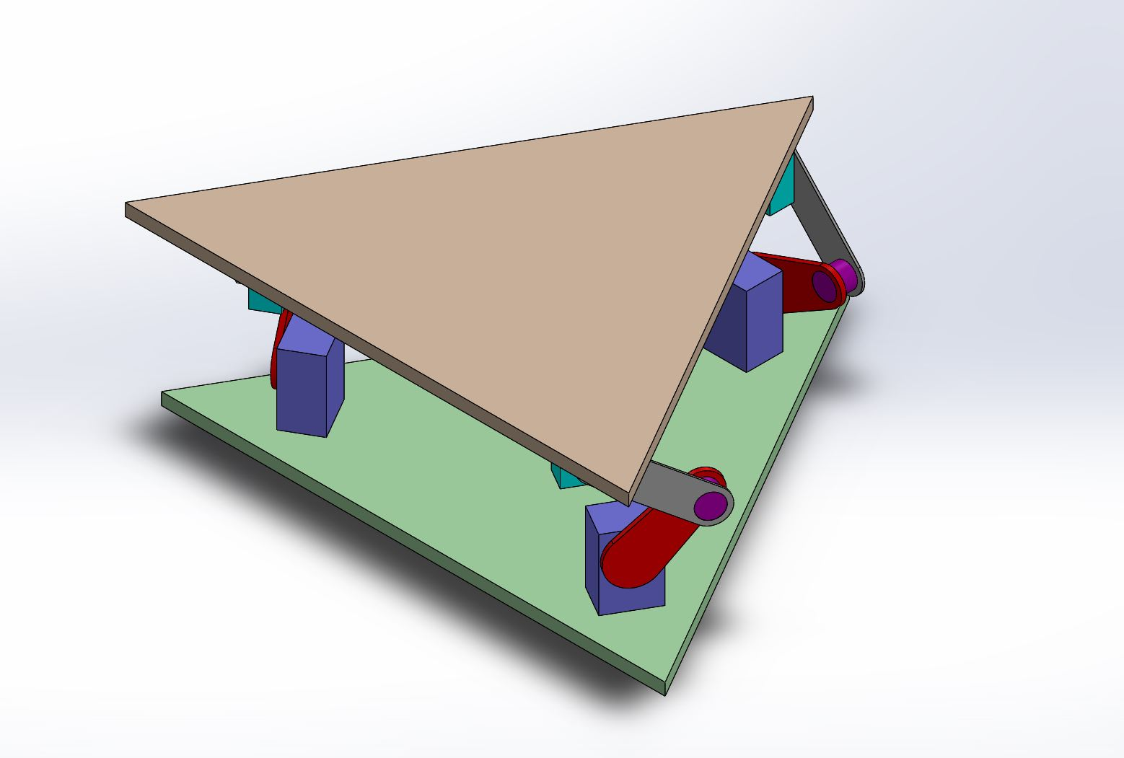
Initial Concept

Slide 13
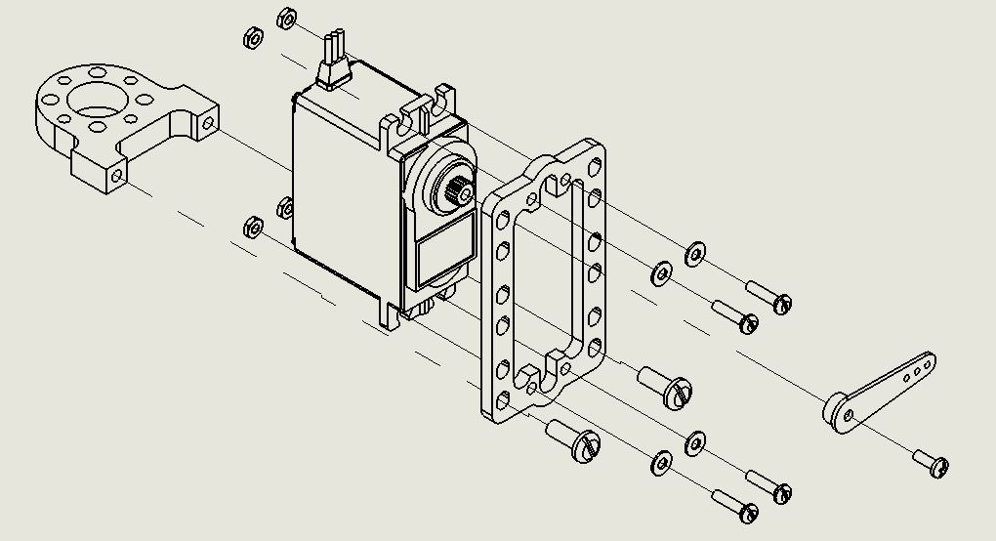
Servo Brackets

Slide 14
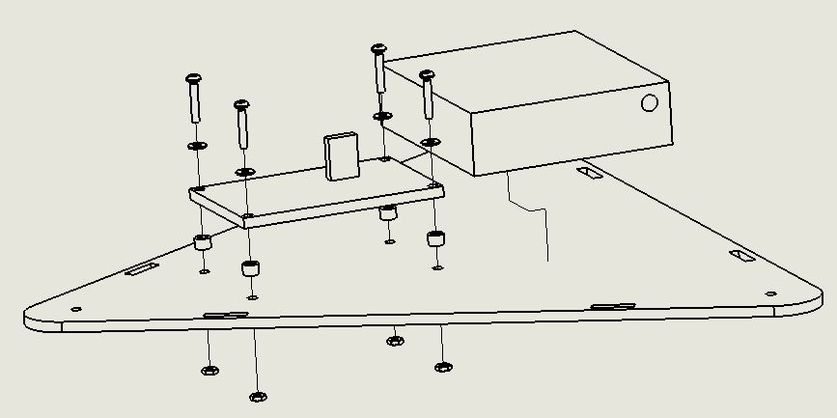
PCB & Battery Placement

Slide 15
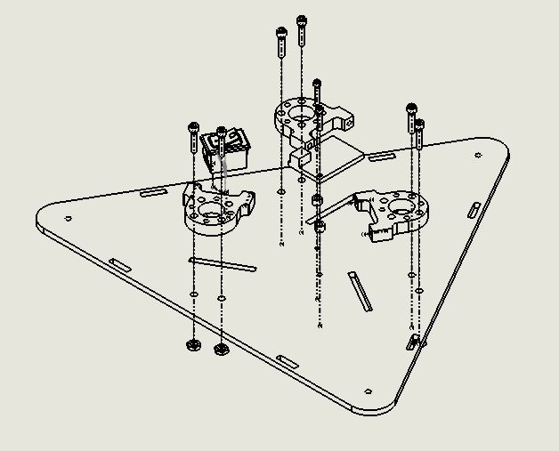
Base to Servo Brackets Mounting

Slide 16
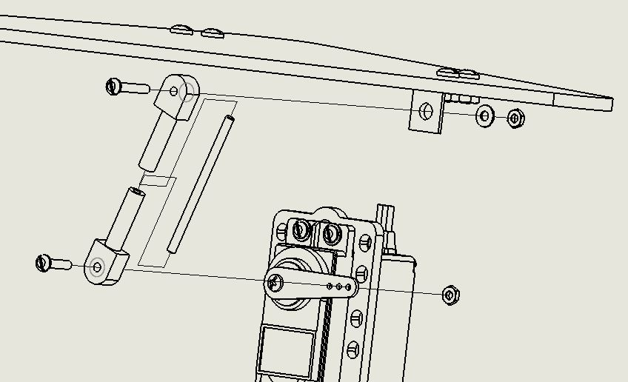
Tray to Base Assembly

Slide 17
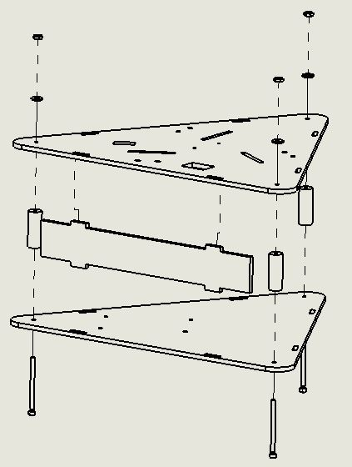
Base Assembly
Base attached with aluminum standoffs
Acrylic side panels used for LED mounting

Slide 18
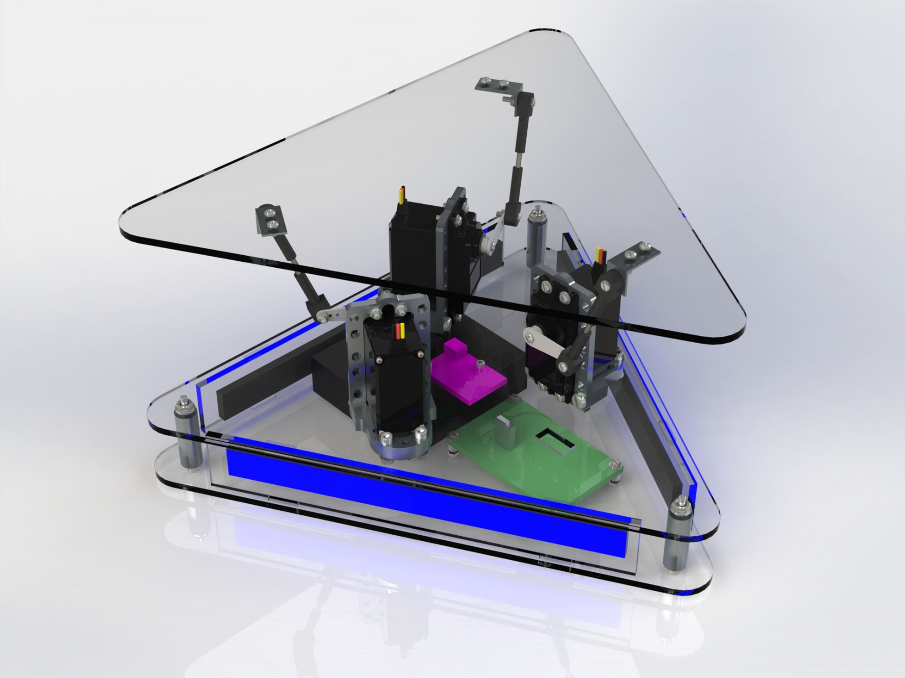
Final Design

Slide 19
Self Leveling Table: Level 0
Self Leveling Table
Gravitational Accelerative Force
System Status
Power,
6 VDC
LED angle display
Module | Self Leveling Table
Inputs | - Gravitational Accelerative Force: The external forces acting on the device, used to determine the angle of the device and set servo position - Power: 6 VDC from batteries.
Outputs | - LED Angle Display: 15 LEDs lit up in different configurations. Lights up based on device tilt slowly changing colors. LEDs around the device become more blue on the device side that is tilted up. LEDs around the device become more red on the device side that is tilted down. - System status: 4 LEDs that light up on PCB. First LED is green, displays when tilt on the x axis reaches its limit. Second LED is yellow, displays when there is communication between the microcontroller and the servo controller. Third LED is yellow, displays when there is communication between the microcontroller and the accelerometer. Fourth LED is red, displays when the tilt on the y axis reaches its limit.
Functionality | - Consists of 2 layers: the base (two triangular acrylic sheets enclosing the batteries, PCB, servos, and LEDs), and the top tray (one triangular acrylic sheet leveled by servos). Receives input from an accelerometer and determines servo position to keep the top tray level.

Slide 20
Self Leveling Table Design: Level 1
Accelerometer Initialization
Oscillator
Gravitational Accelerative Force
Accelerometer
Microcontroller
clock
x y z
values
Status LEDs
System Status
Status info
3.3 VDC
LED strip
control
Servo settings and
positions
Servo 1
Voltage Regulator
6V to 3.3V
Servo Controller
PWM signal
specifying servo arm
position
Servo 2
Logic level shifter
Shifted servo positions
Servo 3
Voltage Regulator
6V to 5V
5 VDC
Shifted LED
Strip control
LED Strip
LED angle display
Power,
6 VDC

Slide 21
UML: Activity Diagram
If servo positions different by 4 degrees or more
Power on device
Initialize and set servos to home position
Initialize accelerometer
Sample Accelerometer
Convert accelerometer data to angles
Calculate servo positions
Yes
No
Send positions to servos
Update LED strip
Delay
Repeat until powered off
*Note: Update status LEDs after every communication and calculation and in the event of an error.

Slide 24
Code
1400 Lines of C
More than 50% reused from manuals or examples online.
Most time consuming.

Slide 25
Code – TWI Communication
TWI → consists of two signal lines SDA and SCL
Manual sheet is the main resource
TWI to enable two way connection between microcontroller and accelerometer
Initialize TWI(I2C) in Atmega328 and setup a serial clock to 400kHz
Generate TWI start signal
Send a byte through TWI
Read a byte from TWI, send an acknowledgment back
Check status register of the TWI

Slide 26
Code – Accelerometer
Format of TWI communication (read and write) provided by MMA8452Q Accelerometer user manual
Write (initialization): start condition, 0x3A (slave address of device, mode), 0x2A (register to write to – system control register 1), 0x07 (800 Hz sample rate, reduce noise, fast read mode, active), stop condition
Read: Start condition, 0x3A (slave address of device), 0x01 (register to start reading from – OUT_X_MSB), repeated start condition, 0x3B (slave address of device, mode), acknowledge each byte, no acknowledge to stop reading

Slide 27
Code – USART
Used to communicate to Servo controller
Transmission and initialization functions come from example C code from ATmega328 manual and specifications from Pololu Servo Controller user manual
Initialization: set baud rate (9600), set format of messages (8 bit, 1 stop bit, no parity, asynchronous mode), enable transmitter
Transmission: make sure transmit buffer is empty, put byte into transmit buffer

Slide 28
Code – Servo Controller
What needs to be transmit provided by Pololu Servo Controller user manual (SetTarget, SetSpeed, SetAcceleration,SetMultipleTargets)
Pololu Protocol: 0xAA (baud rate indication byte), 0x0C (device number), command byte (with most significant bit cleared), command data
SetTarget: 0x84 (command), channel number, target low bits, target high bits
SetSpeed: 0x87 (command), channel number, speed low bits, speed high bits
SetAcceleration: 0x89 (command), channel number, acceleration low bits, acceleration high bits
SetMultipleTargets: 0x9F (command), num targets, first channel num, first target low bits, first target high bits, second target low bits, …

Slide 29
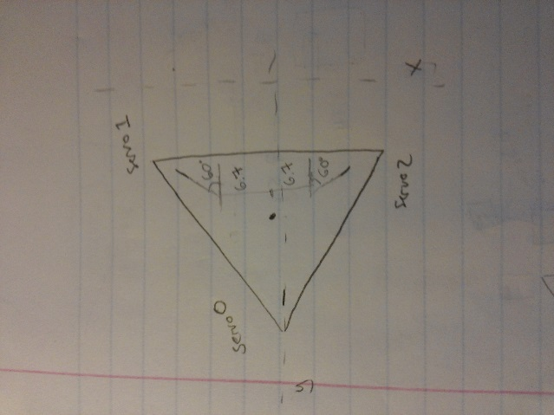
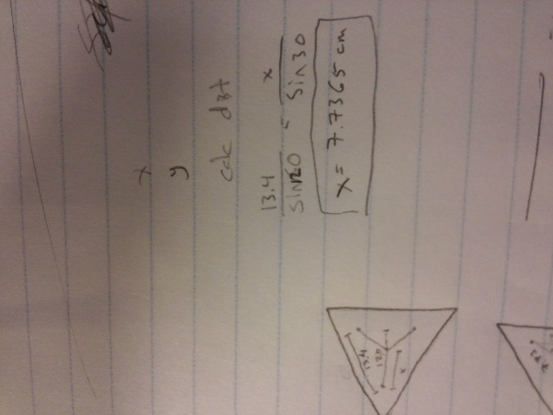
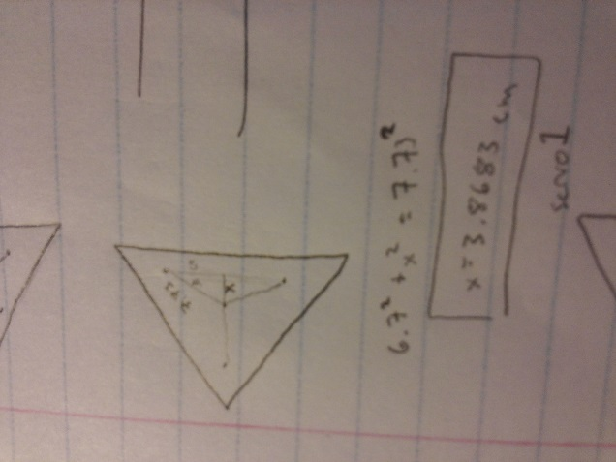
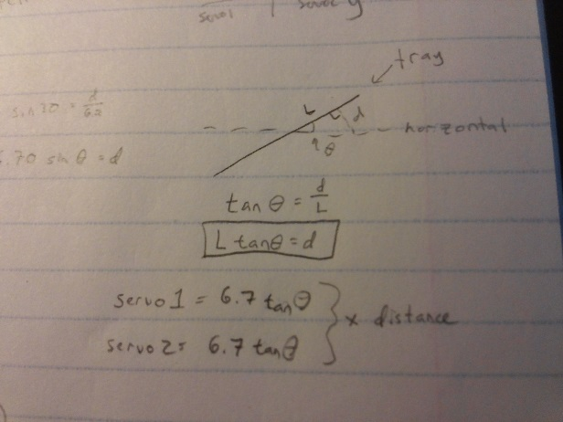
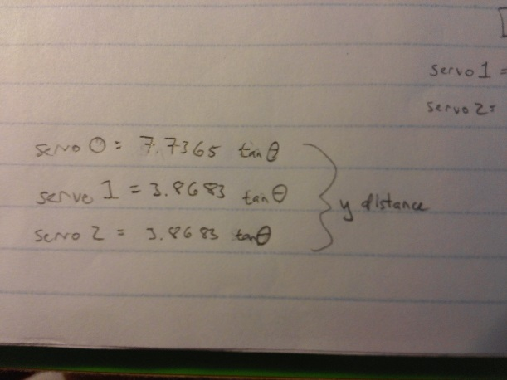
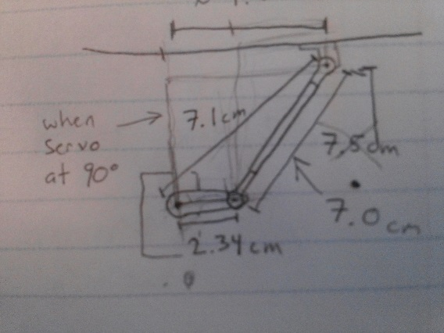
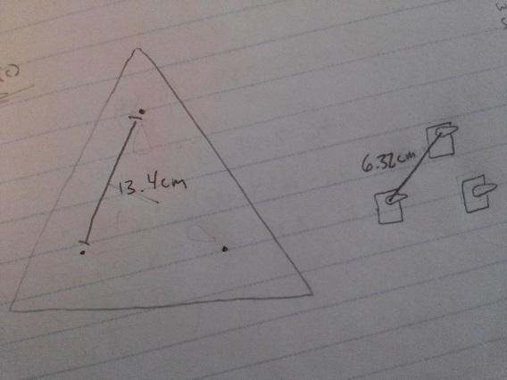
Servo Position Calculation
Consists of 2 parts:
Servo angle to tray height
Distance the tray is off from the home position

Slide 30
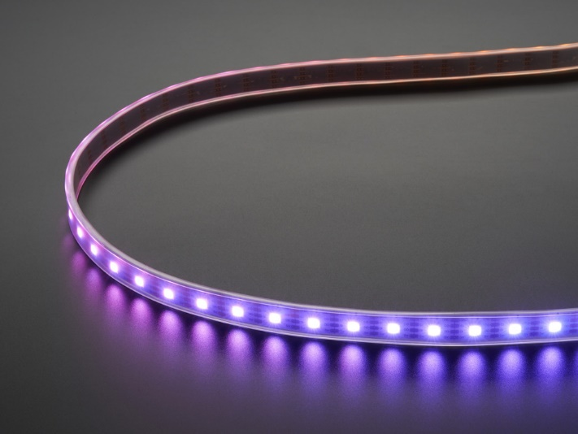
Adafruit Dotstar
Dotstar vs. NeoPixel
Easy interfacing
Adjustable length
Arduino Library

Slide 31
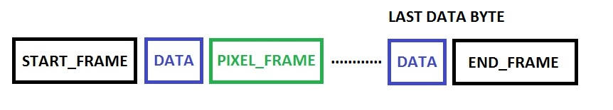
SPI Communication
1 Byte per pixel
15 pixels total

Slide 32
Main Program Flow
Initialize the LED strip
Set initial colors
output to LED strip
Initialize the Servo Controller
Initialize USART in microcontroller
Set speed of servos
Set all servos to home position
Fill Lookup table with servo angle to height mappings
Initialize the accelerometer
Initialize microcontroller for TWI communication
Change settings in Accelerometer

Slide 33
Main Program Flow
Sample accelerometer
Sample 400 times and take average
Blink the accelerometer communication yellow status LED
Update the green and red status LEDs
Servo adjustment
Calculate distance off from home position
Search through table to find correct servo angle position
Update LED strip based on servo angle positions
Move servos if they are 4 degrees or more off from previous position
Servo movement delay
Repeat from sample accelerometer

Slide 34
Tools Used
SolidWorks
Eagle
Atmel Studio
AVR Dragon Programmer
GitHub
Repository
Wiki
LID
Laser Cutting Acrylic
Soldering Stations and Oven

Slide 35
IP and Prior Work
Atmel Code (atmega328 datasheet)
TWI Interfacing
USART Interfacing
Internet Search Code
BlinkLED (Testing initial setup)
electroSome (https://electrosome.com/blinking-led-atmega32-avr-microcontroller/)
Binary Search Algorithm
Programming Simplified (http://www.programmingsimplified.com/c/source-code/c-program-binary-search)
LED Strip Control
Adafruit (https://learn.adafruit.com/adafruit-dotstar-leds/overview)
Accelerometer Data Conversion
Sparkfun (https://github.com/sparkfun/MMA8452_Accelerometer/blob/QC-Rev/Firmware/MMA8452Q_BasicExample/MMA8452Q_BasicExample)
Arduino
Angle – PWM Mapping
Arduino Servo Library

Slide 36
IP and Prior Work
Lots of YouTube videos with examples.
https://www.youtube.com/watch?v=ZrZodwEHjew
https://www.youtube.com/watch?v=T0SFAdPUUYs
https://www.youtube.com/watch?v=5uR34U1qc-Q
https://www.youtube.com/watch?v=K-F_T59ZDPw
https://www.youtube.com/watch?v=uERF6D37E_o
https://www.youtube.com/watch?v=enlQMUE9df4
https://www.youtube.com/watch?v=j4OmVLc_oDw

Slide 37
Testing
Functional Test
Materials needed:
Arduino
Arduino IDE
Arduino accelerometer example code
Verify accelerometer outputs valid measurements
Verify servos are operable
Verify Servo controller operates servos
Verify LED strip operation
Verify microcontroller operation
Run full system leveling test

Slide 38
Testing
Integration Test
Materials needed:
Atmel Studio
AVR Dragon Programmer
Microcontroller to Servo controller (USART) communication
Accelerometer to Microcontroller (TWI) communication
Microcontroller level shifting (buffer)

Slide 39
Testing
Parametric Test
Materials needed:
Oscilloscope
Multi-meter
Output voltage from voltage regulators
External oscillator frequency
Range of servos

Slide 40
Testing
Stress Test
Materials needed:
Randomly distributed weights
Test maximum tray weight

Slide 41
Results
Most things worked well.
Servo arms could work better.
LEDs are nice and bright.
Rx on Microprocessor from servo controller Tx not stepped down to 3.3V.
No resets.
Need better errors and cleaner code.

Slide 42
Contributions
Sean
Mechanical Design, LED Strip control code, GitHub guru.
Waleed
TWI Code, Servo arm assembly.
Adrian
Servo arm design, torque calculations, USART code, servo position algorithm, code formatting.
Taylor
Hardware design, schematic, layout, soldering, LED strip angle color code.
Everyone!
Homework, testing, assembly, coding something.

Slide 43
Lessons Learned
What did we learn?

